Slide 1


QUEST
Integrated Voltage Management
Andrew Howard
SP ENW - INNOVATION
05/11/2025
Notes:
Update cover

Slide 2
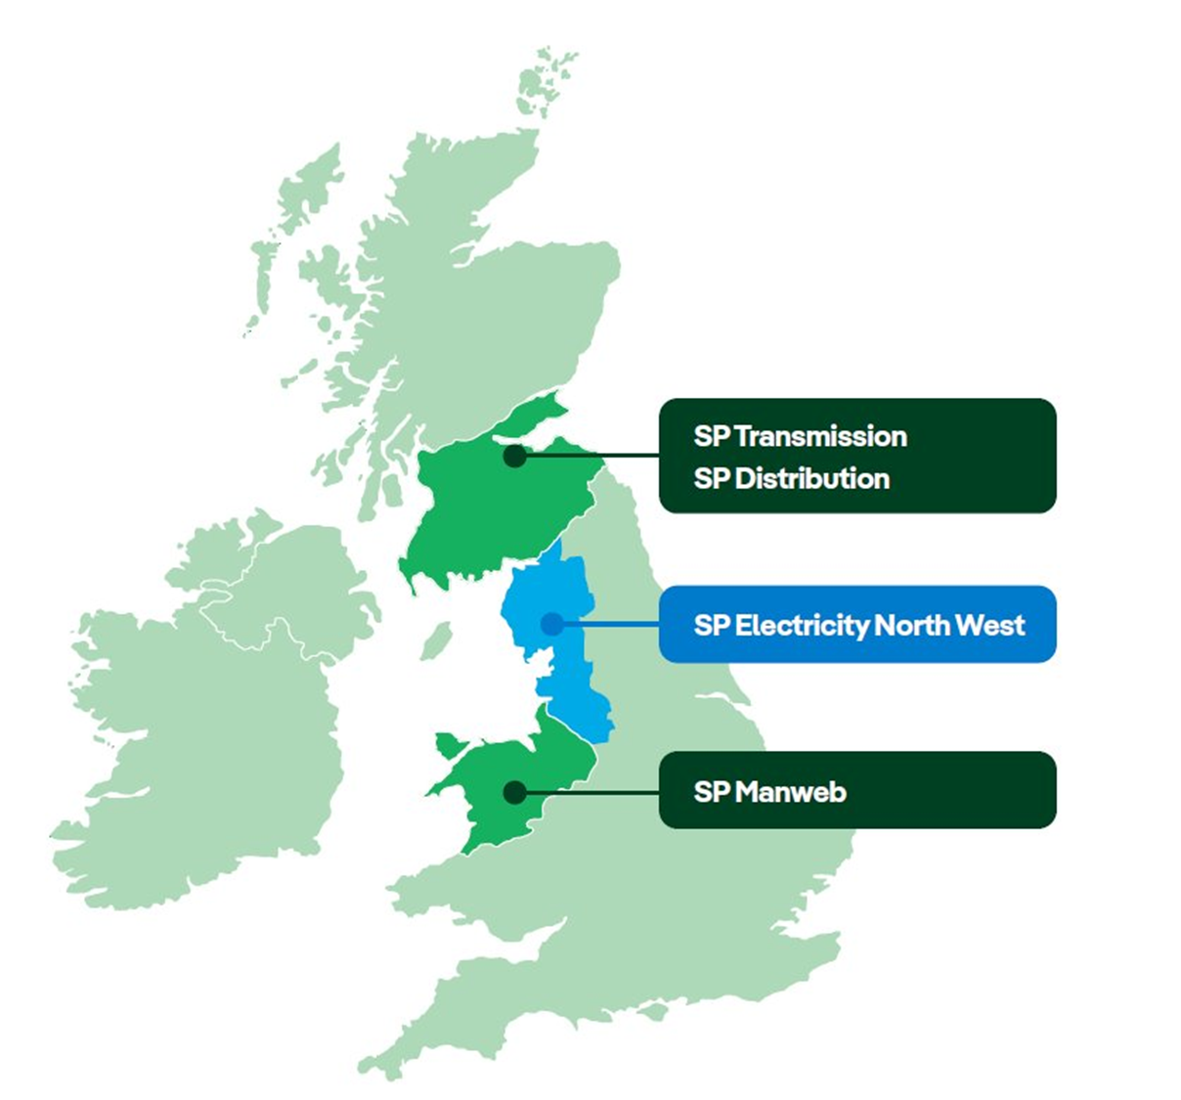






QUEST Explained
  QUEST - £7.95m NIC project awarded November 2020.
  Due to run April 2021 to April 2025 but delayed (December 2025).
  QUEST is a whole-system voltage optimisation system, comprising software held centrally within a network management system, alongside intelligent devices fitted in substations.
  QUEST will co-ordinate the actions of multiple voltage control and optimisation techniques, including CLASS, Smart Street and Active Network Management (ANM), holistically across the whole system to optimise their use and facilitate the increased use of Low Carbon Technologies (LCTs).
Why is QUEST Needed?
QUEST demonstrates active Voltage Control across all of the DNO network voltages can be optimised to maximise the use of the existing network and allow for the increased uptake of LCTs and the subsequent increase in demand on the network.
DNOs have deployed several discrete voltage management techniques to manage the networks. QUEST will address their inherent limitations by fully coordinating their use.

Slide 3
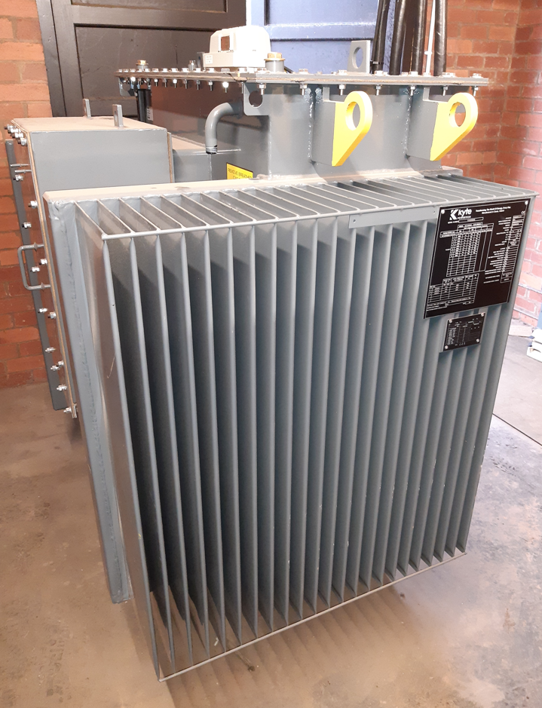
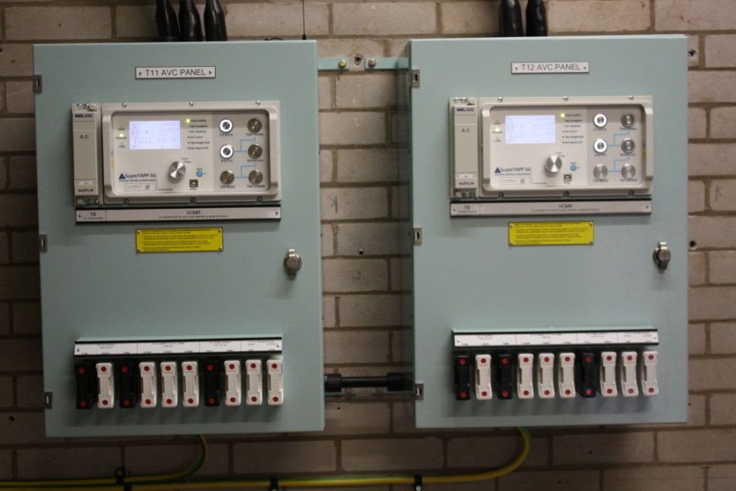
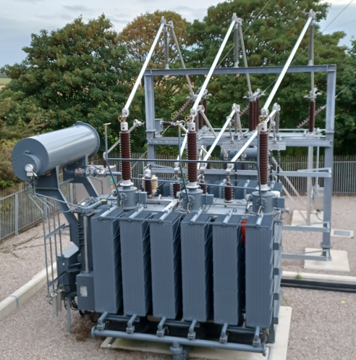
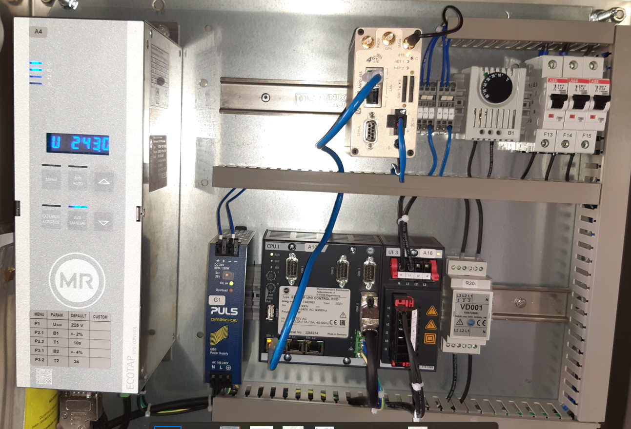

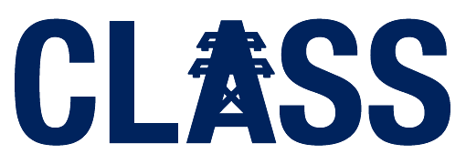

The Project
Innovation Funded
Now Business as Usual
Innovation Funded
Now Business as Usual
New Innovation
132/33 kV QUEST element
New Distribution OLTC Install (Smart St standard) & access to existing units
Additional CLASS response steps
Upgrade to 33/HV Voltage Control systems
Application of enhanced 33/HV solution to 132/33 system
  First time functionality at this Voltage level
New QUEST Overarching Control System software
  Full Control at all Voltage levels below Whitegate Grid Supply Point
  Optimise / maximise voltage control at each voltage level
  Interface with other elements of Network Management e.g. ANM, Emergency situations
  Development of Digital twin – to inform and corroborate results

Slide 4

Headline Findings (1 of 3)
  QUEST – It does what it says on the tin !
QUEST can control voltage at all Network Levels
QUEST can optimise voltage across all levels based on priorities set
QUEST will maximise benefits, once all priorities have been met
QUEST can integrate with 3rd party customer systems and modify their operation
QUEST benefits can be verified against modelling with a digital twin model
QUEST can do this using standard SP ENW network equipment

Slide 5

Headline Findings (2 of 3)
  Customer Engagement
Our Domestic and SME Customers continue to be unaware of active network voltage management.
Engagement with EHV and HV Customers has been challenging.
Barriers include:
        Technical Knowledge
        Financial and Business Impact understanding
        Willingness and time to engage, especially where no issues currently exist
Engagement has resulted in a better understanding of to communicate with this specialist audience.
A small subset of customers, predominately LCT generation & very flexible demand users, may be interested in voltage managed connections, but they will need much greater detail and contract specifics to understand IF the benefits from such contracts would be advantageous.

Slide 6
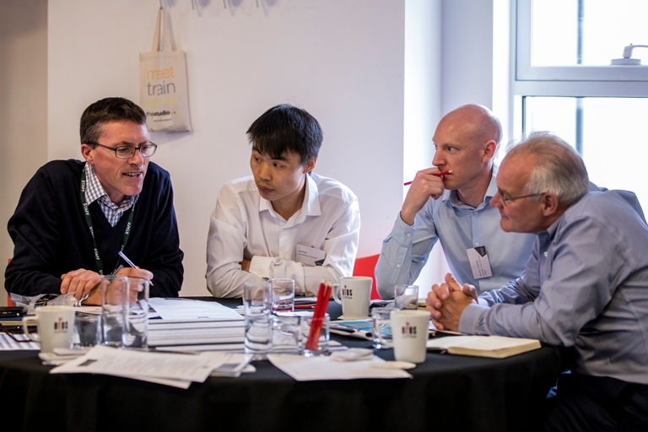

Headline Findings (3 of 3)
  Lessons
The core innovation in the project, developing use cases, technical design, software design, installation, testing and customer engagement went relatively smoothly.
The project suffered major issues and delay resulting from an IT change and a significant shift in world affairs, leading to changes in the risk and resourcing environment for Cyber Security and Critical National Infrastructure.
QUEST key IT challenges:
      Separation of QUEST software onto a mini-NMS system
      Additional IT hardware and IT support arrangements to provide partners the required secure access to systems
      Additional system integration with multiple ICCP connections
      Resourcing challenges to support new systems and methods of working

Slide 7
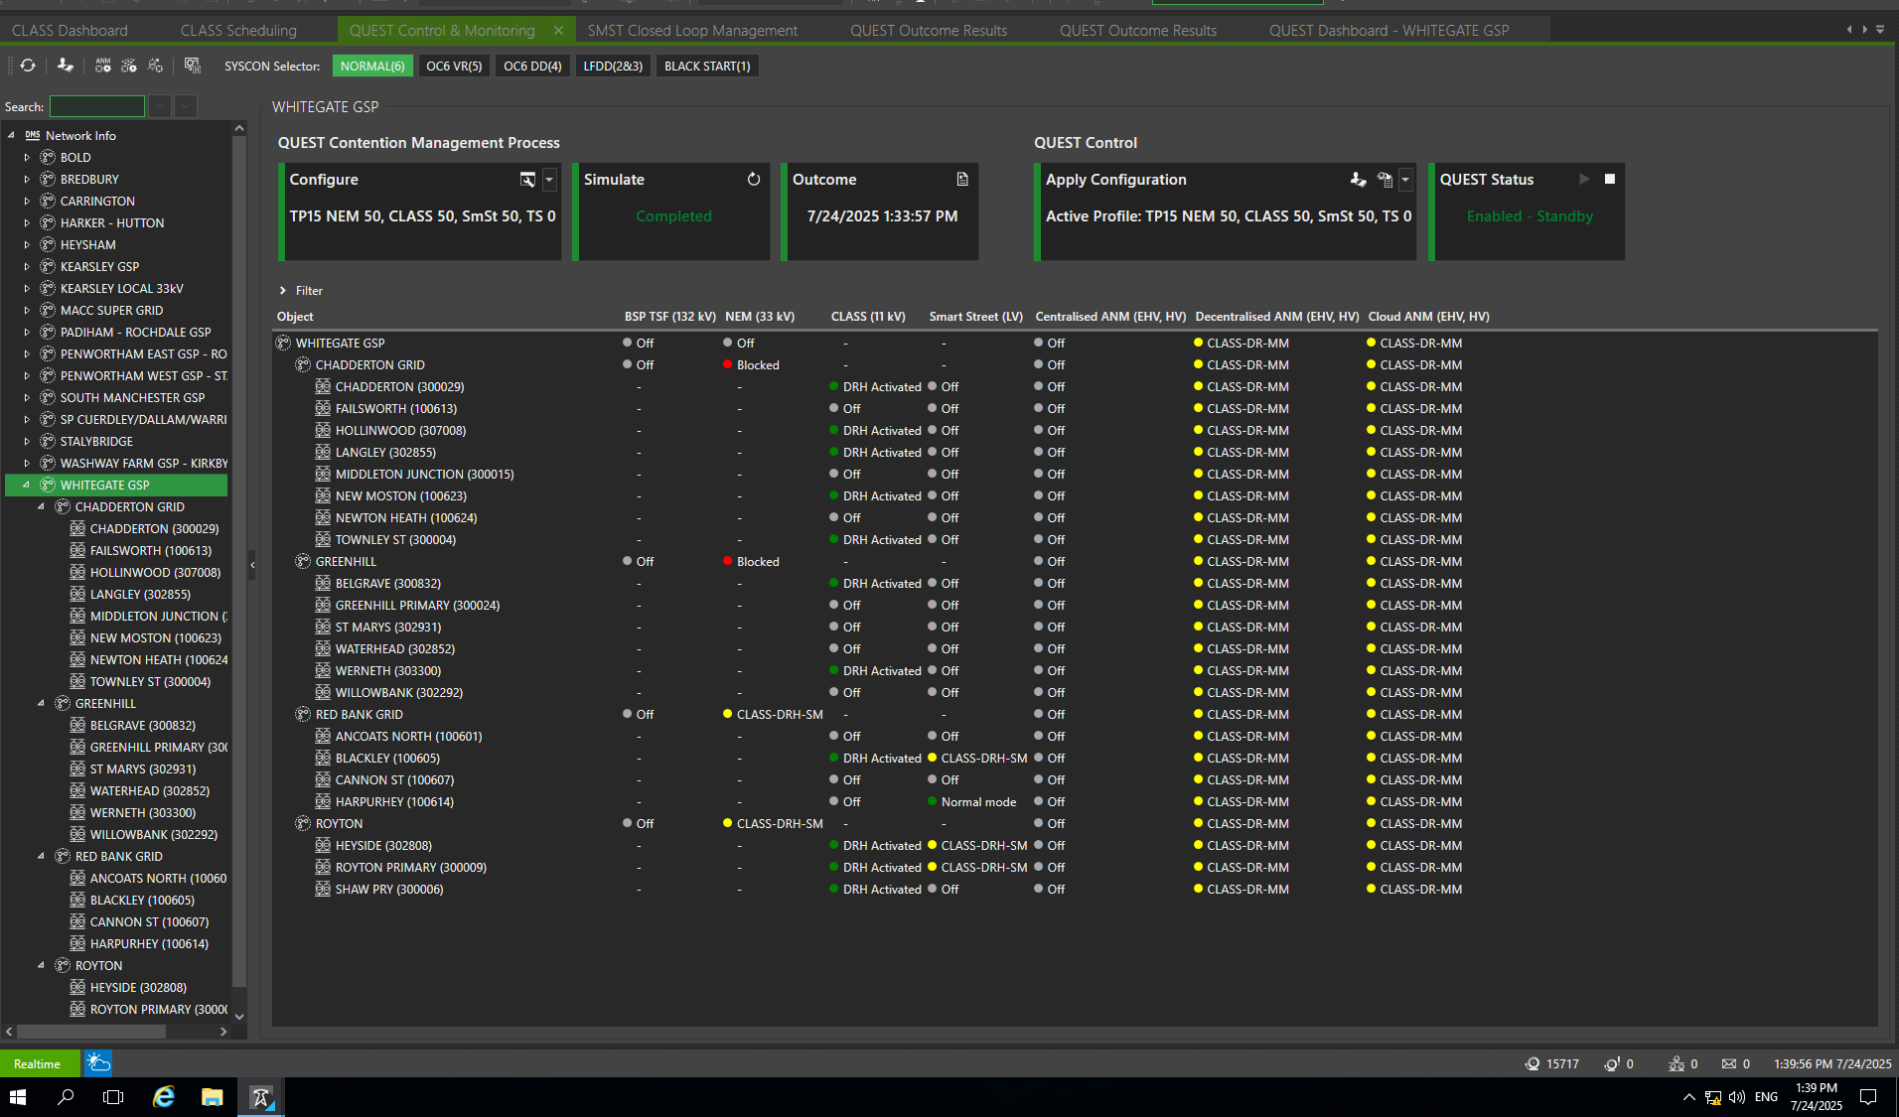
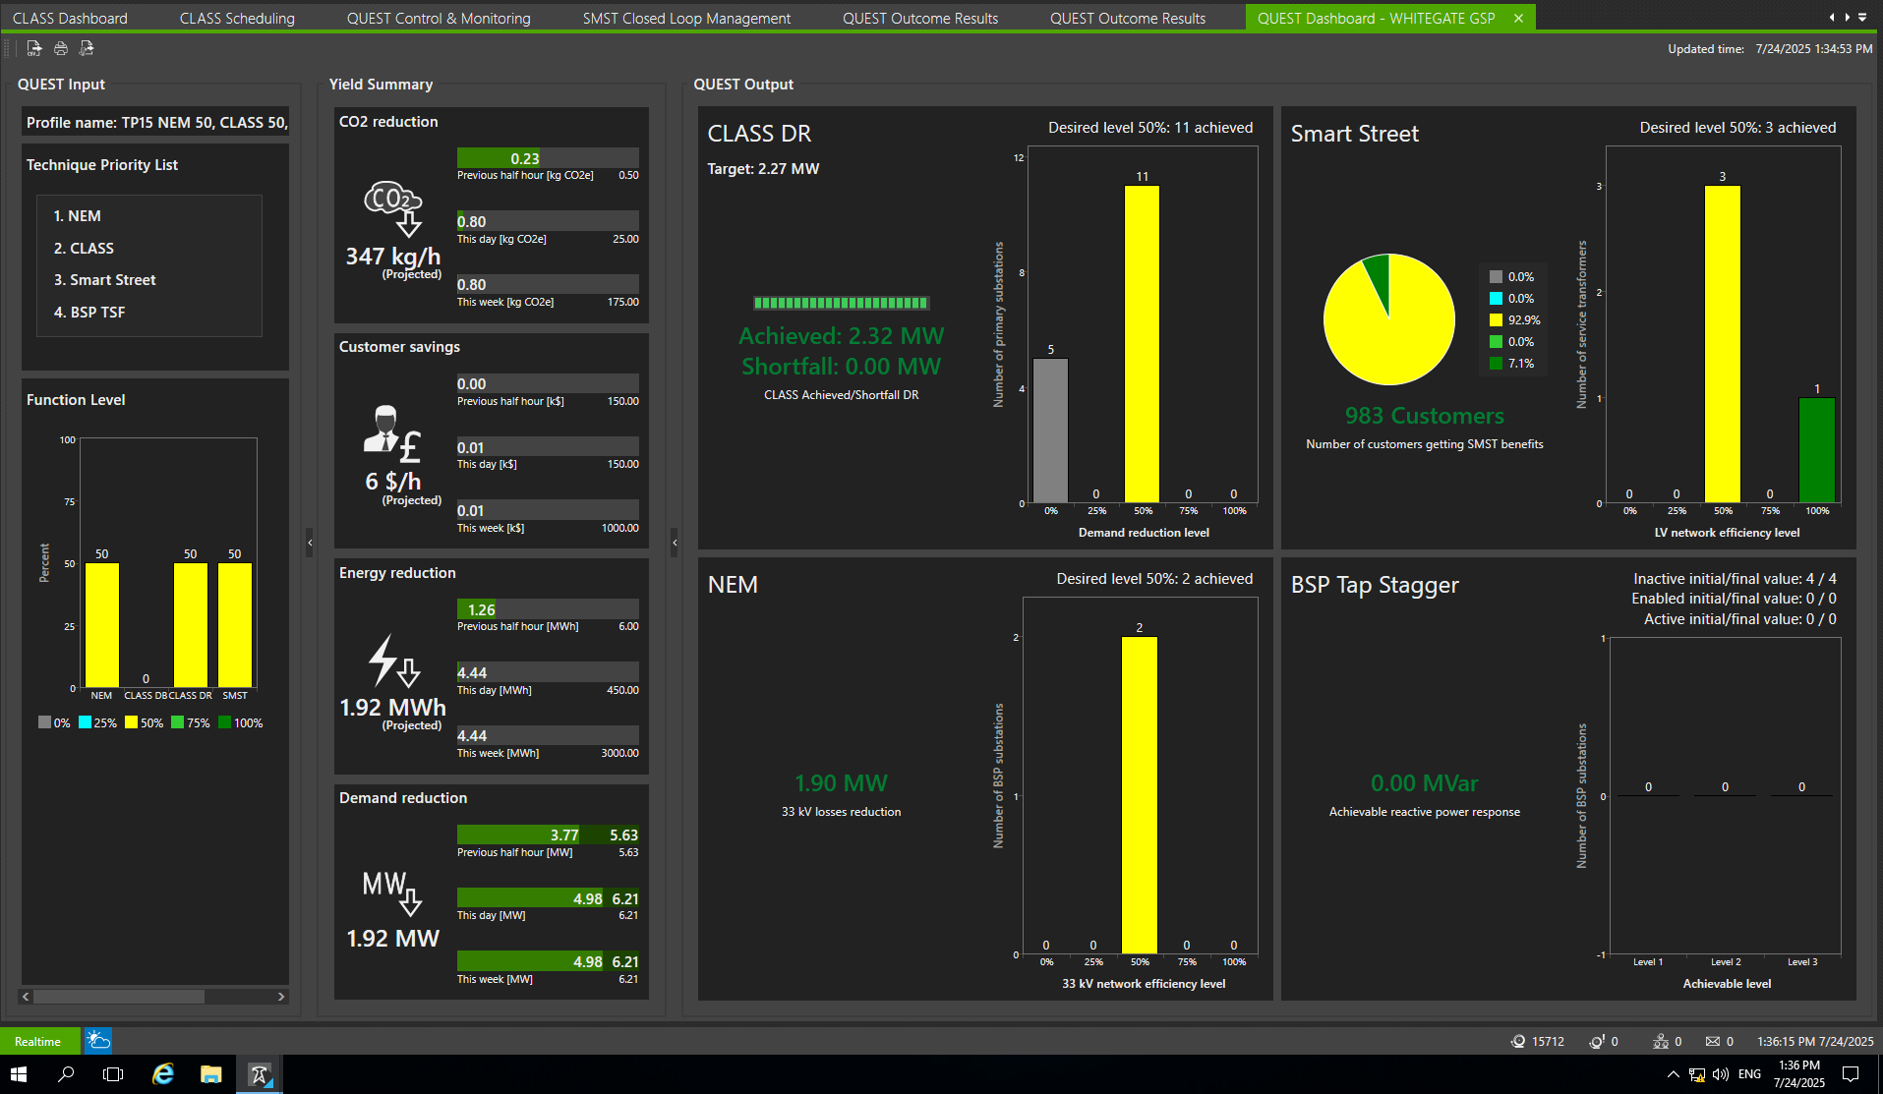
Trials & Analysis
  Trials and Analysis Report due 28 Nov 2025.
A QUEST test includes:
Four Key Functions:
    Smart Street
    CLASS
    NEM
    BSP Tap Stagger
Function Level per function
    E.g. 0%, 25%, 50%, 75%, 100%
    QUEST Control & Monitoring Dashboard
    Ability To Configure, Test & Control
    Whitegate Network Tree:
    Site availability (Real Time)
    Function and levels selected
    Impact on ANM systems
Benefits Summary
    Volumes of sites/customers by function selected and function level
    Summary benefits from normal operation

Slide 8
Transition to Business as Usual (1 of 3)
  The original project submission, in October 2020, had assumed a simple low-cost transition to BaU.
A lot has happened in that 5-year period, and the focus of Voltage Management in the industry has changed, with competing voices on what changes and for what purposes should occur.
  Project Context
QUEST functionality has delivered the intended and expected outcomes, but….
The IT infrastructure changes, required to mitigate the enhanced cyber risk, impacted the degree of integration with existing control room systems that could be achieved in the project.
A BaU solution would need to include design and configuration work for this integration.
However,
The core QUEST software is written and understood
Modifications to include lessons learnt in the project was planned for
System integration with other NMS functionality is core SE & SP ENW skill set

Slide 9
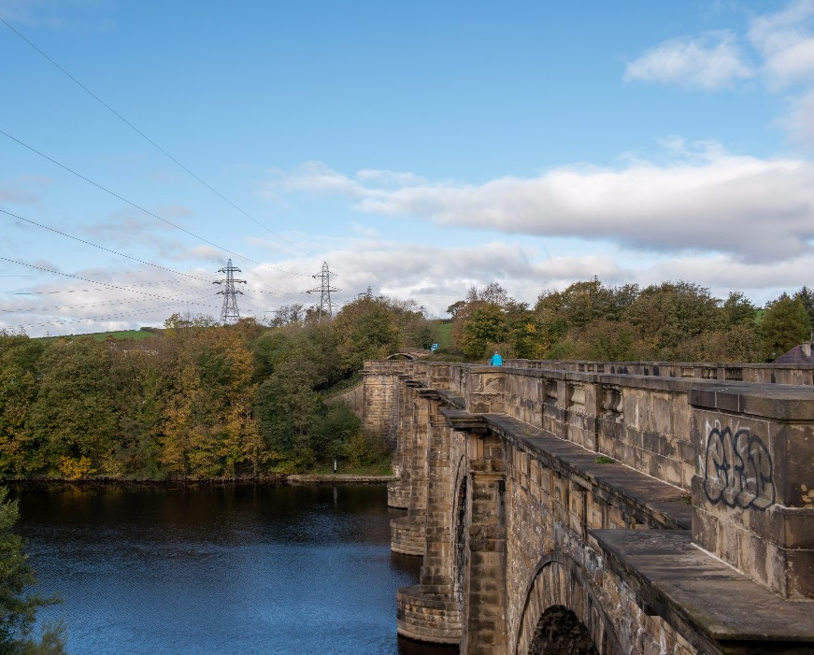
Transition to Business as Usual (2 of 3)
  Organisational Context
CLASS has been commercially operational since 2019.
In 2024, NESO flagged a market change to the “Optional Fast Reserve” market, resulting in system changes being required for CLASS to contribute to the new “Slow Reserve” market.
Whilst this did not immediately impact the QUEST project, it does mean QUEST software will need updating to reflect the necessary changes now being made to the CLASS software.
During the project, the core SP ENW NMS product became due for an upgrade. The work to deliver the latest NMS functionality is due to complete in 2026.
This will also result in changes to the QUEST software before its integration into the upgraded NMS system.

Slide 10
Transition to Business as Usual (3 of 3)
  Industry Context
Voltage management and active voltage management has become a hot topic in the industry over the last 12-18 months.
Projects, such as QUEST, continue to demonstrate what can be done within the ESQCR voltage limits for the benefit of end consumers and low carbon technologies, without the effects of this management being noticed.
However:
Are the ESQCR limits now appropriate?
Especially at LV, do these limits need updating? (e.g. lowering or broadening)
Where and for who should any opportunities created by change be utilised?
(DNO, DSO, NESO, end consumers, certain LCT above others, demand or generation)
The outcomes to this debate may impact the benefits for a QUEST system

Slide 11

Deliverables and Next Steps
6. Customer Research
Published 29th September 2025
7. Trials & Analysis
To be published 28th November 2025
Dissemination Event
In Person - Central Manchester
10th December 2025
8. QUEST Final report
To be published 19th December 2025

Slide 12

Want to know more?
EIS Stand
The SP ENW team are here all event to answer any questions we can
Many of our project partners are also here
QUEST Closedown Dissemination Event
Central Manchester, Wednesday 10th December
SP ENW Website
All the projects output have and will be published at:
https://www.enwl.co.uk/future-energy/innovation/key-projects/quest/
e-mail
Innovation@enwl.co.uk

